Slide 1
Applied Data Science
Ideation phase
Group 4

Slide 2
Introduction:
Ideation is the process where you generate ideas and solutions through sessions such as Sketching, Prototyping, Brainstorming, Brainwriting, Worst Possible Idea, and a wealth of other ideation techniques.
Ideation is also the third stage in the Design Thinking process.

Slide 3
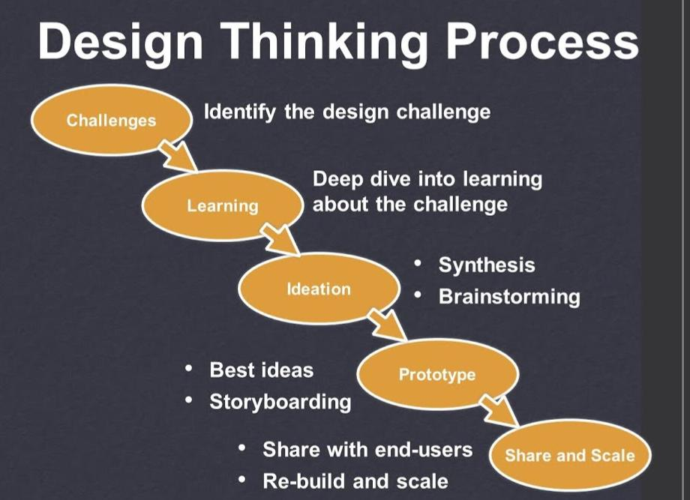

Slide 4
Problem statement:
A problem statement is a description of an issue to be addressed or a condition to be improved upon.
It identifies the gap between the current problem and goal.
The problem statement should be designed to address the Five Ws.
Purpose:
The purpose of the problem statement is to identify the issue that is a concern and focus it in a way that allows it to be studied in a systematic way.

Slide 5
How to write a problem statement:
Describe how things should work. ...
Explain the problem and state why it matters. ...
Explain your problem's financial costs. ...
Back up your claims. ...
Propose a solution. ...
Explain the benefits of your proposed solution(s) ...
Conclude by summarizing the problem and solution.

Slide 6
Empathize:
Design Thinking cannot begin without a deeper understanding of the people you are designing for.
In order to gain those insights, it is important for you as a design thinker to empathize with the people you’re designing for so that you can understand their needs, thoughts, emotions and motivations.
The good news is that you have a wide range of methods at your command for learning more about people.
The even better news is this: with enough mindfulness and experience, anyone can become a master at empathizing with people.

Slide 7
Strategies to Develop Empathy:
Cultivate curiosity. ... Step out of your comfort zone. ... Receive feedback. ... Examine your biases. ... Walk in the shoes of others. ... Difficult, respectful conversations. ... Join a shared cause. ... Read widely.

Slide 8
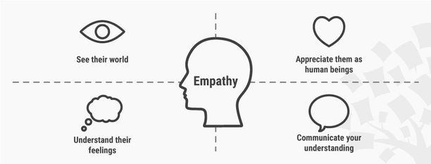

Slide 9
Discover :
Discover is a consumer credit card brand known for its cash-back rewards program and reduced fee structure.
Discover Financial issues its cards directly to its customers without using intermediate bank issuers and thus profits directly from the interest earned on their credit card balances.

Slide 10
Brainstorming Ideas :
Brainstorming is a group problem-solving method that involves the spontaneous contribution of creative ideas and solutions.
This technique requires intensive, freewheeling discussion in which every member of the group is encouraged to think aloud and suggest as many ideas as possible based on their diverse knowledge.

Slide 11
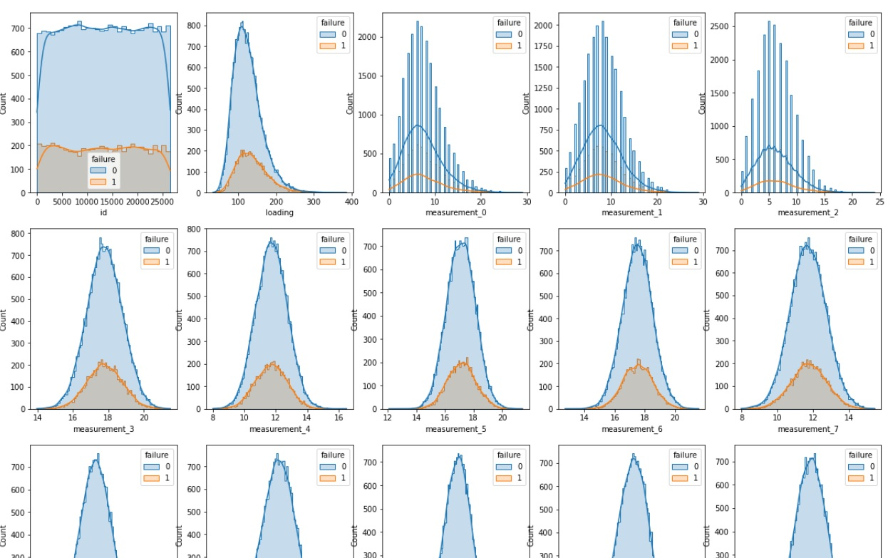

Slide 12
If I can read that right, it means that at any reading of the measurements, you have an fixed ratio of failure or non-failure (around 25%)
It means that (1) using one feature is almost equal to using all to predict the failure, and (2) none of these features is separately cabaple of explaining failure. If all scores in the leaderport are still below 60%, it means that the significant feature has not yet emerged.
I have tried different ways to see the pattern, I even tried to classify the data using PCA, it turns out the data is consisting of three isolated islands (see below), which at the beginning, was very interesting find:

Slide 13
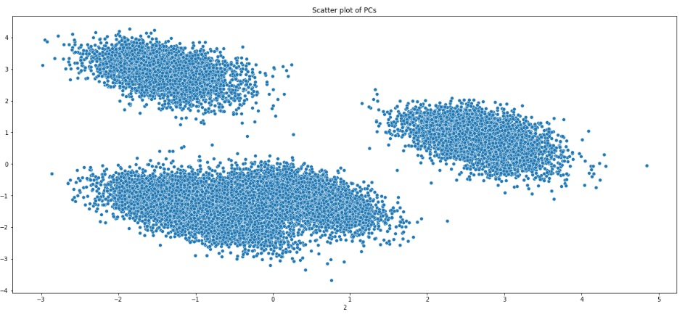

Slide 14
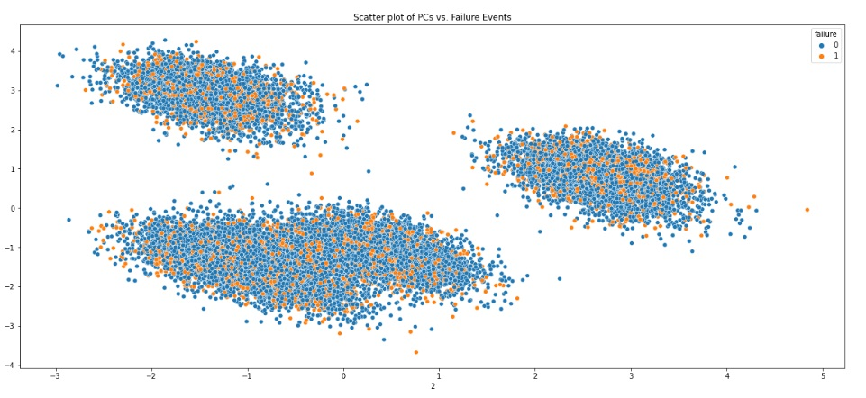
Afterwards, I tried to look for the pattern of the failure event in these islands, and the excitement immediately receded:
,

Slide 15
Prioritize Ideas :
the state or quality of being earlier in time, occurrence, etc.
the right to precede others in order, rank, privilege, etc.;
precedence. the right to take precedence in obtaining certain supplies, services, facilities, etc.,
especially during a shortage. something given special attention.

Slide 16
​Example list of priorities for life:
Eating a nutritious diet. Getting regular exercise. Staying out of debt. Saving enough money to buy a home. Doing things that generate happiness. Pursuing a mission or purpose. Going to therapy to work on anxiety or depression. Spending a summer in Europe.

Slide 17
